Slide 1
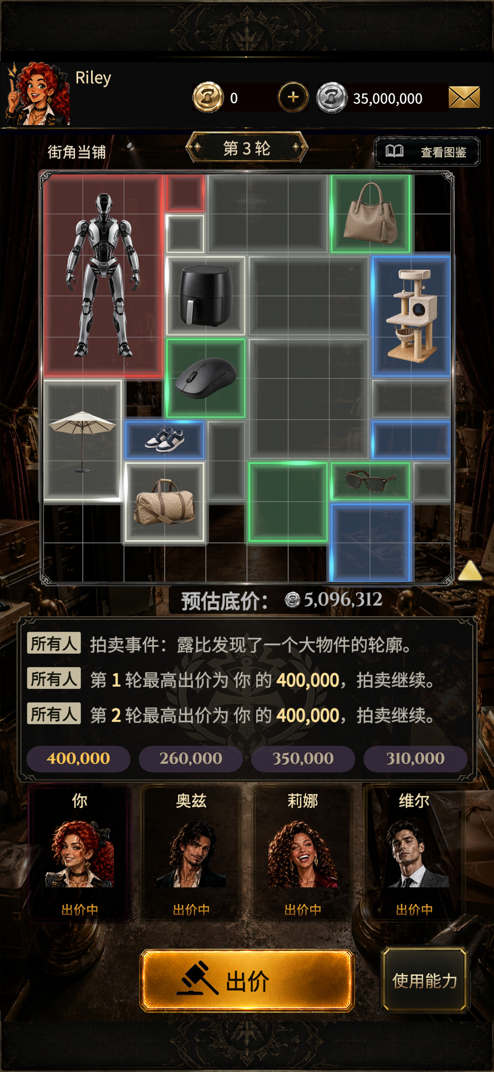

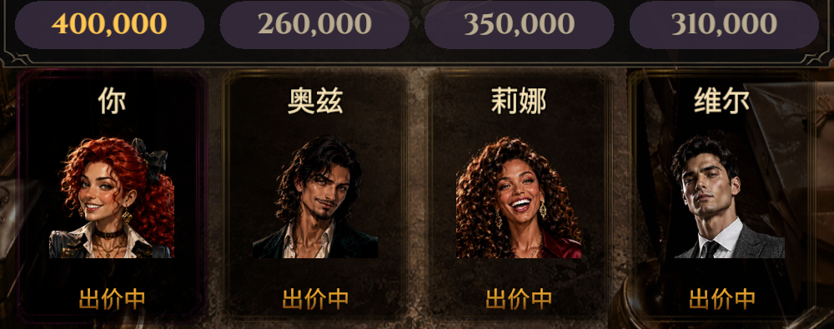
Investment & Publishing Proposal
Portrait midcore casual / IAA + IAP
Four rivals read the clues
and bid for hidden treasures
Read clues, estimate value and bid in secret.
Reveal the loot, then collect or sell it.
01
Notes:
01
Four rivals read the clues
and bid for hidden treasures
Read clues, estimate value and bid in secret.
Reveal the loot, then collect or sell it.
Investment & Publishing Proposal
Portrait midcore casual / IAA + IAP

Slide 2
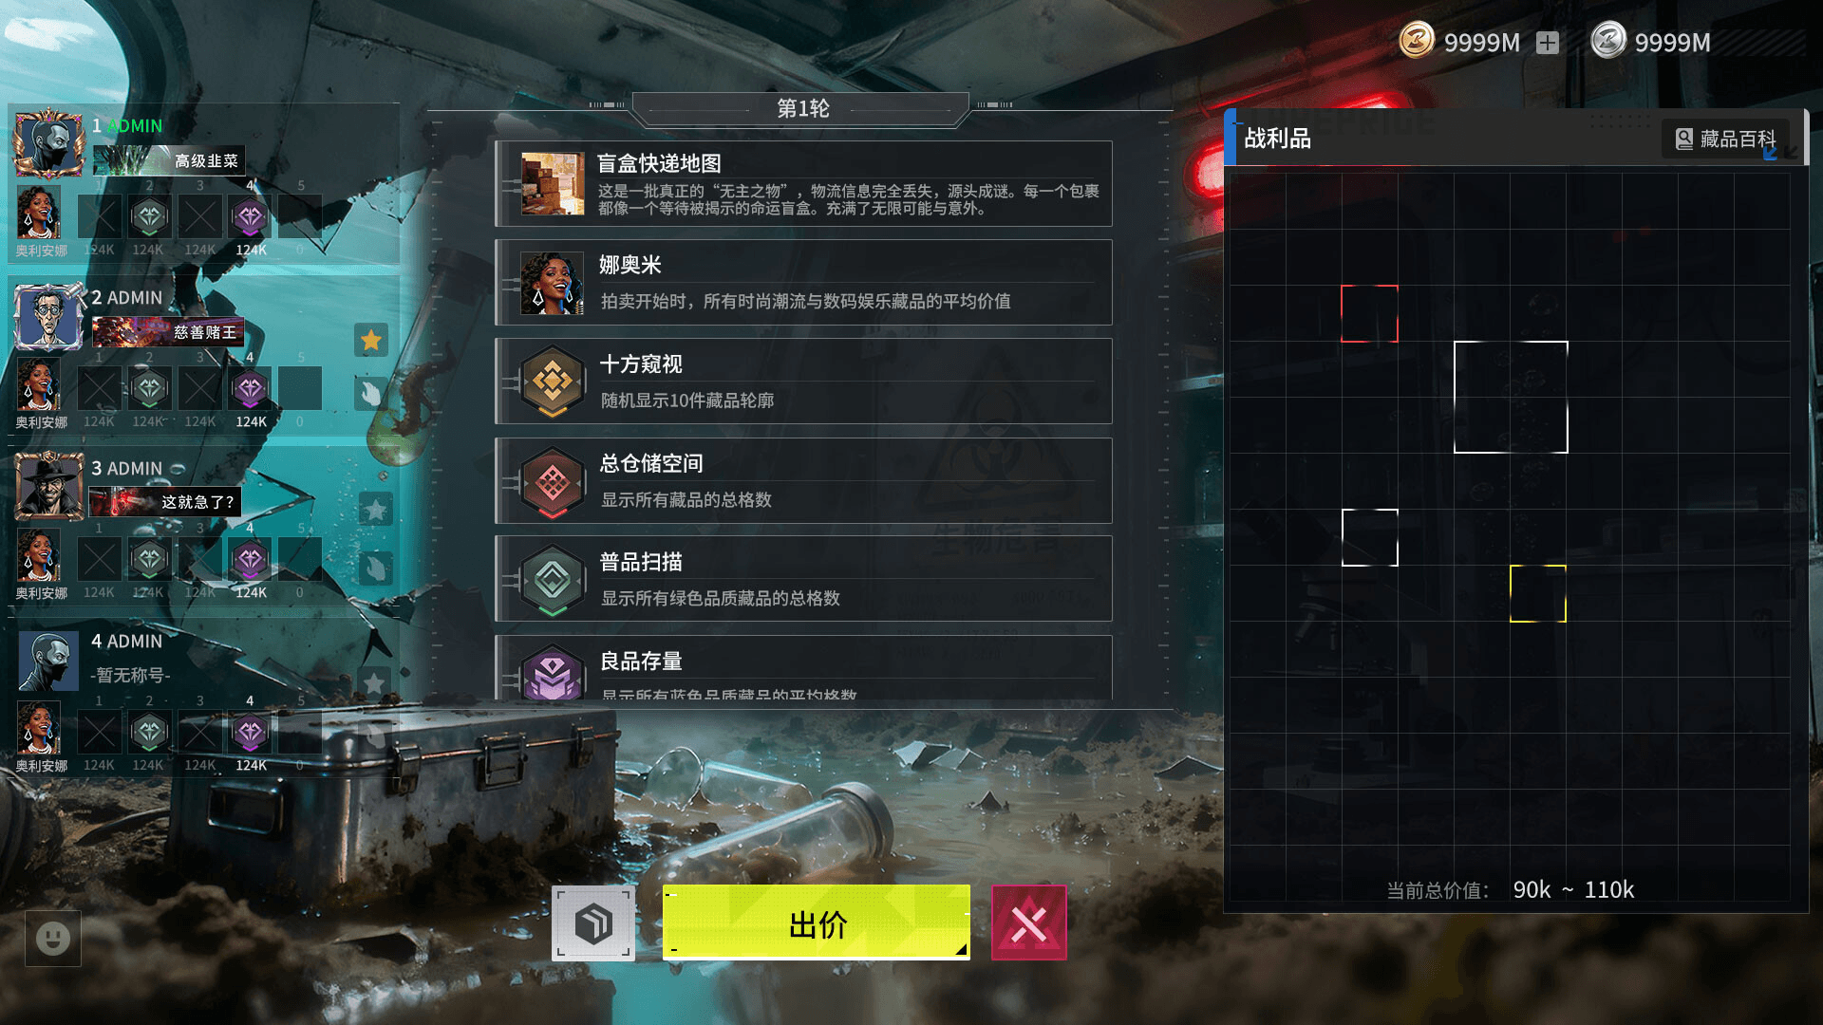
Auction gameplay has achieved commercial success on Steam
BidKing: peak reach and later commercial results
Metric and period | Publicly reported figures
All-time peak concurrent players | 57,450 players
Peak concurrent players, Aug 2026 | 13,946 players
First-month unit sales (estimate) | Over 1.1M copies
Gross revenue reported in August: approx. US$10.4 million
02
Notes:
Auction gameplay has achieved commercial success on Steam
02
BidKing: peak reach and later commercial results
Metric and period
Publicly reported figures
All-time peak concurrent players
57,450 players
Peak concurrent players, Aug 2026
13,946 players
First-month unit sales (estimate)
Over 1.1M copies
Gross revenue reported in August: approx. US$10.4 million

Slide 3
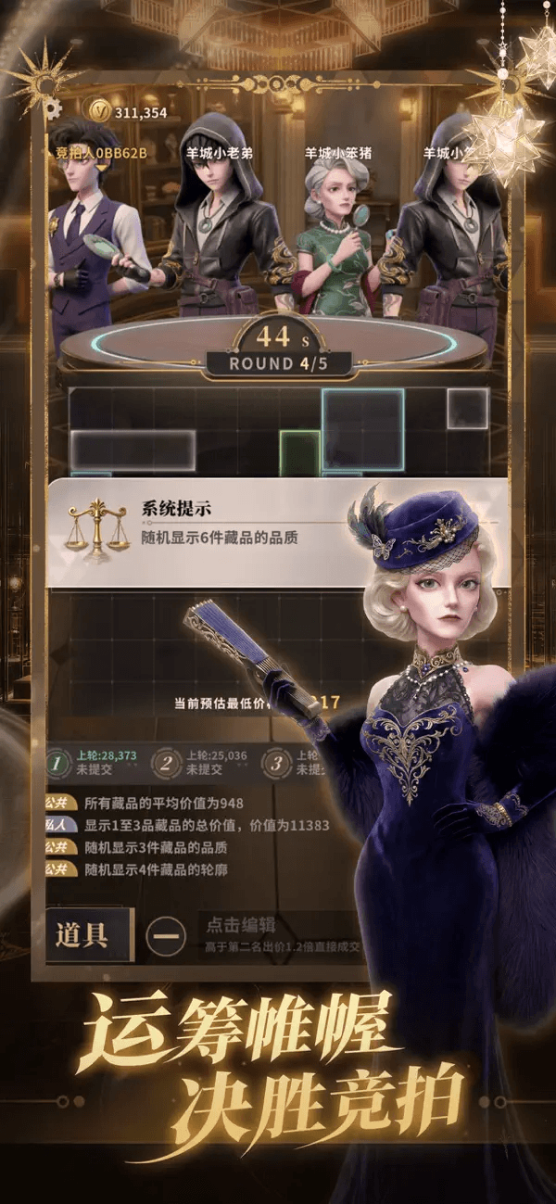
Similar auction mini-games
rank among China's top sellers
No. 21
Jule Da Wanjia
Best-ever WeChat mini-game grossing rank
Product metric | Jule Da Wanjia: public results
Douyin mini-game popularity chart | Peak No. 12 (as of 3 Sep)
WeChat mini-game grossing chart | Entered on 5 Aug 2026
03
Notes:
Similar auction mini-games
rank among China's top sellers
03
No. 21
Jule Da Wanjia
Best-ever WeChat mini-game grossing rank
Product metric
Jule Da Wanjia: public results
Douyin mini-game popularity chart
Peak No. 12 (as of 3 Sep)
WeChat mini-game grossing chart
Entered on 5 Aug 2026

Slide 4
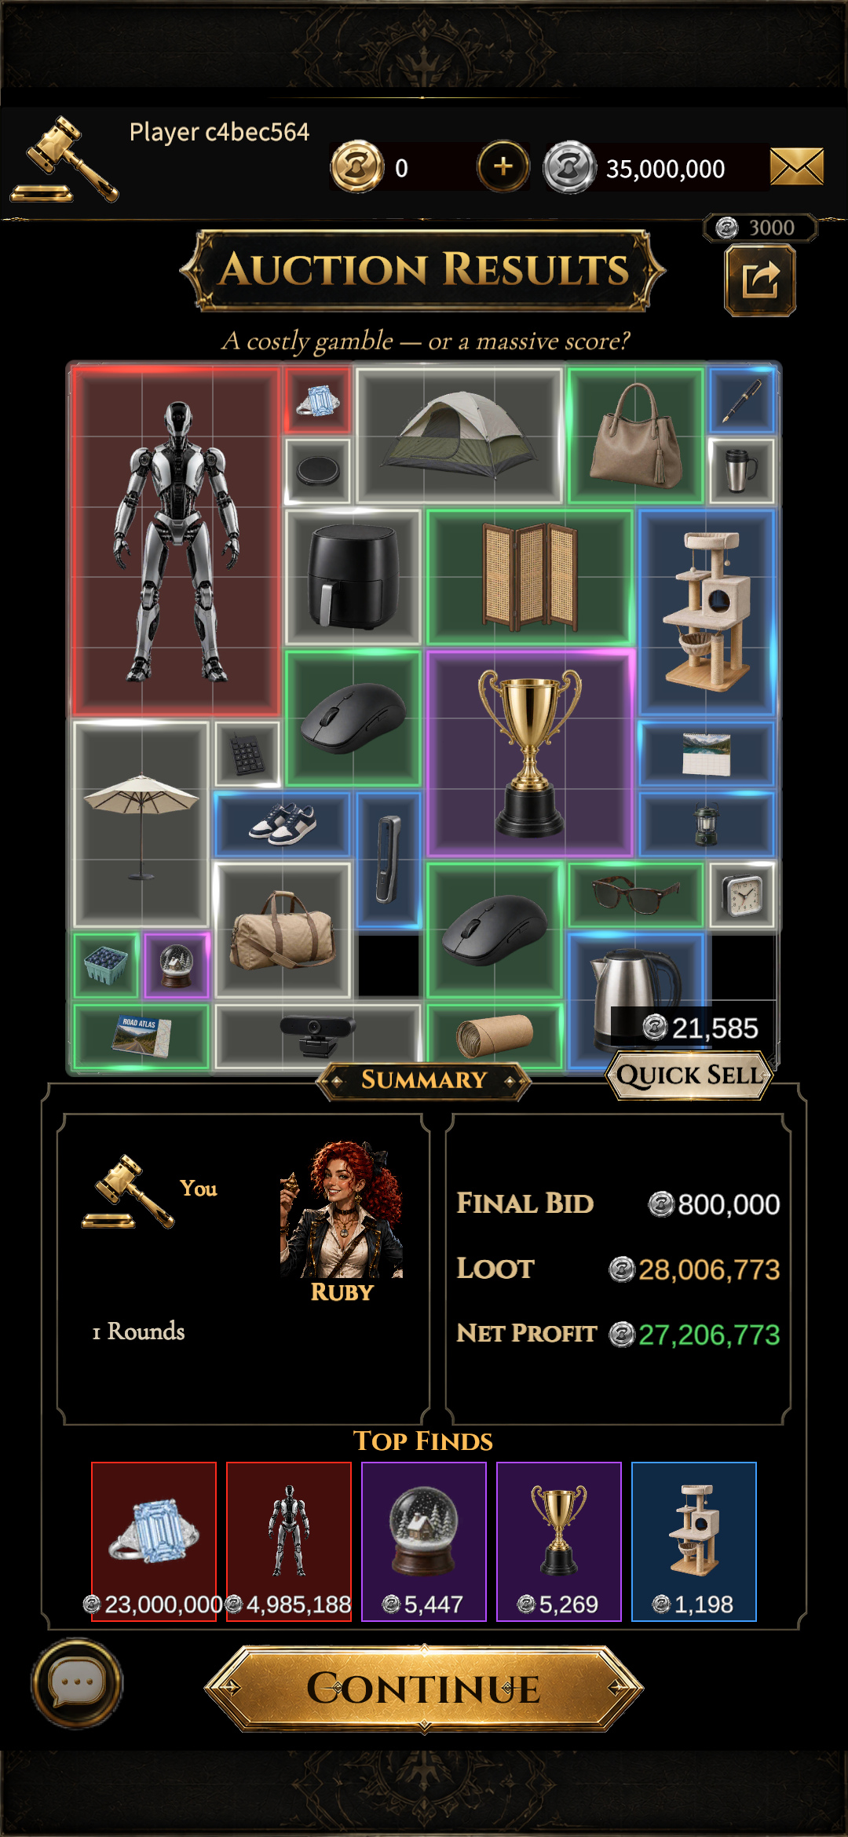
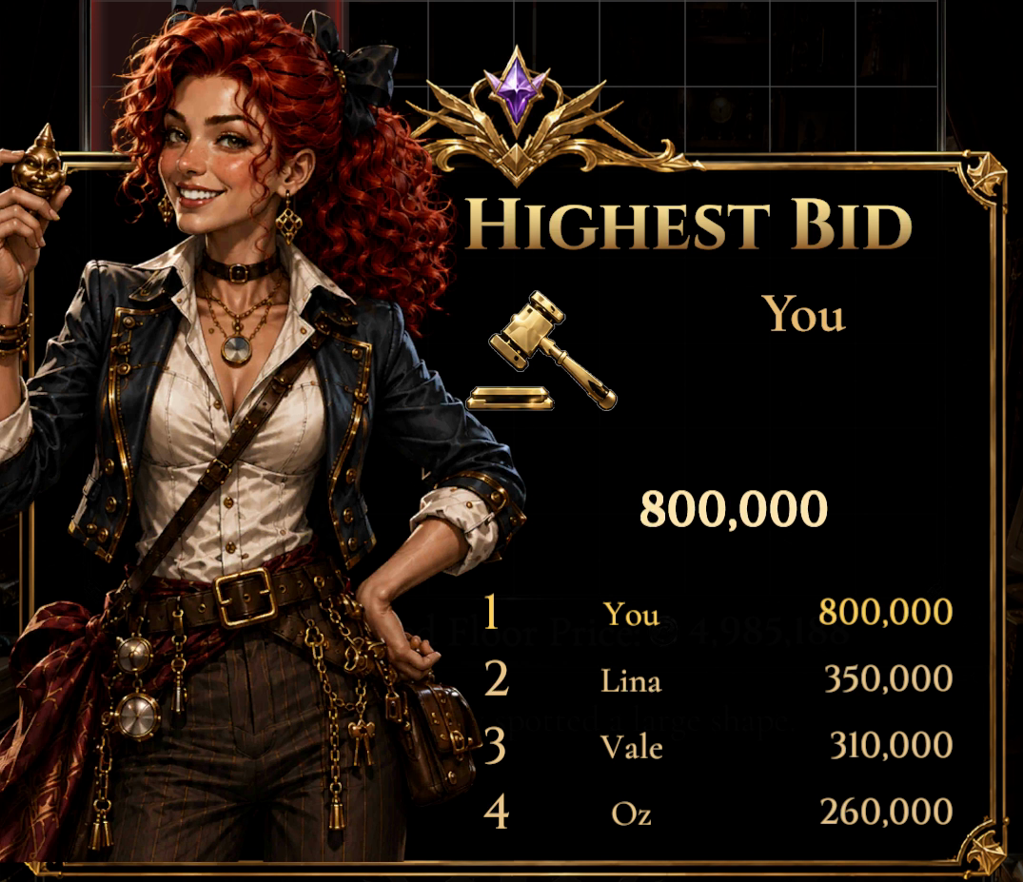
Win ultra-rare items
and big in-game profits
Winning bid
800K
Net in-game gain
27.207M
In-game silver
04
Notes:
Win ultra-rare items
and big in-game profits
04
Winning bid
800K
Net in-game gain
27.207M
In-game silver

Slide 5
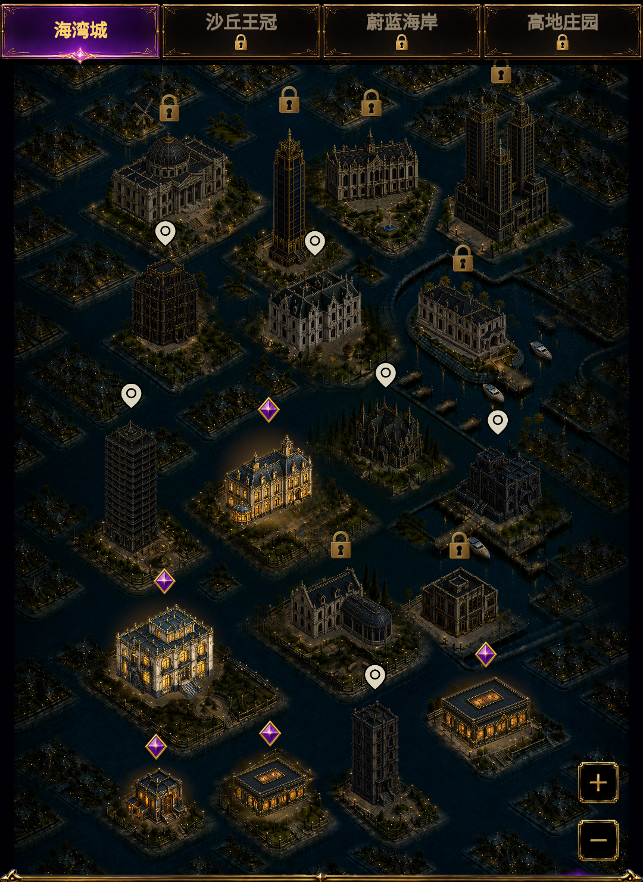
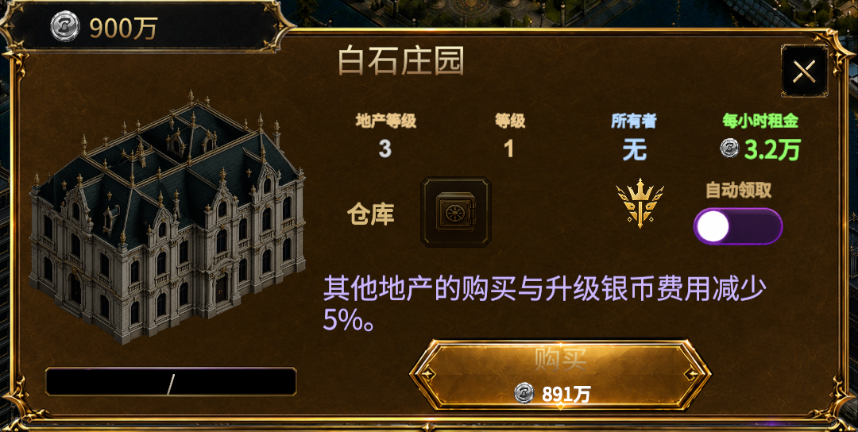



Property ownership adds
a distinctive long-term loop
Starter property
Manor
Grand palace
05
Notes:
05
Property ownership adds
a distinctive long-term loop
Starter property
Manor
Grand palace

Slide 6




















A rich cast with plenty of ways to customize
Different characters, multiple skins each
Cosmetics: frames, titles and emotes
Titles
Emotes
Ruby · Default
Ruby · Skin 2
Damian
Naomi
06
Notes:
A rich cast with plenty of ways to customize
06
Different characters, multiple skins each
Ruby · Default
Ruby · Skin 2
Damian
Naomi
Cosmetics: frames, titles and emotes
Titles
Emotes

Slide 7
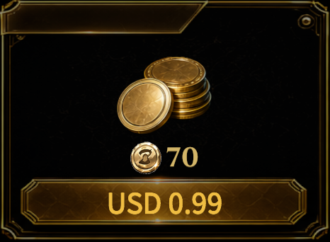
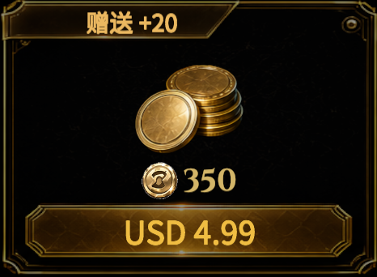
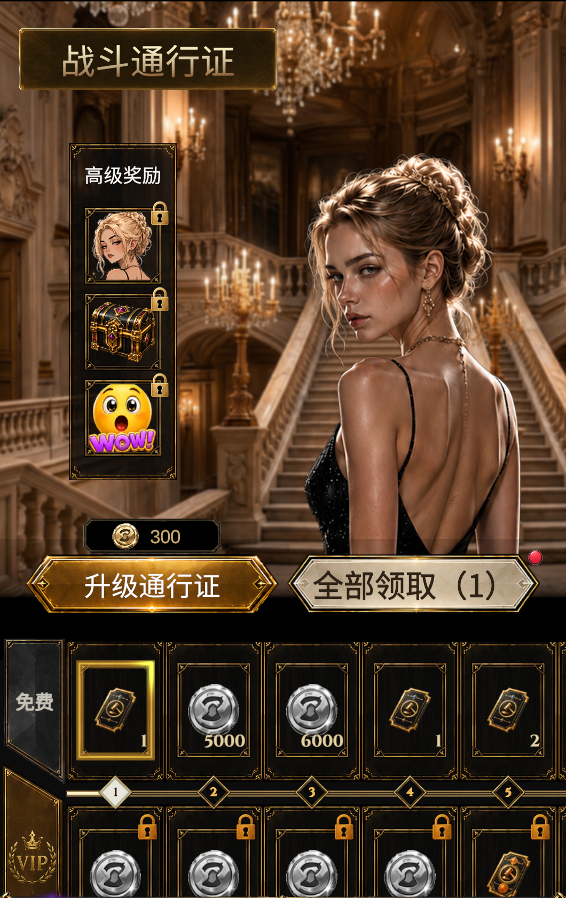
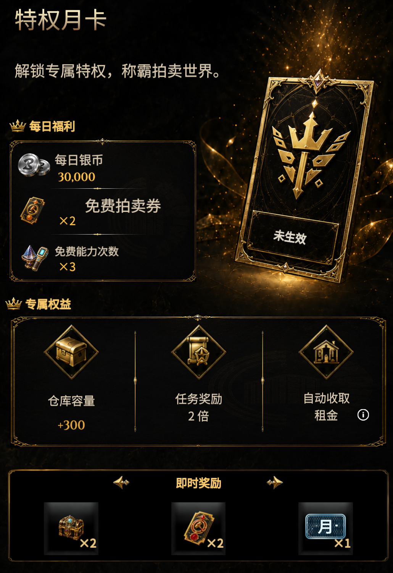
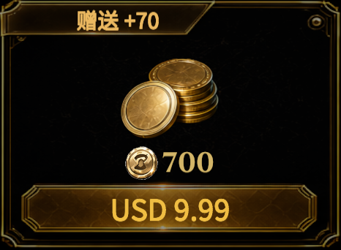
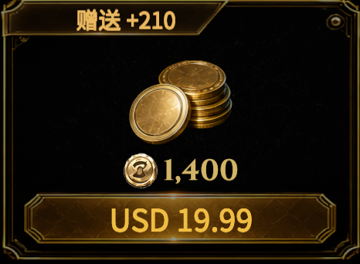
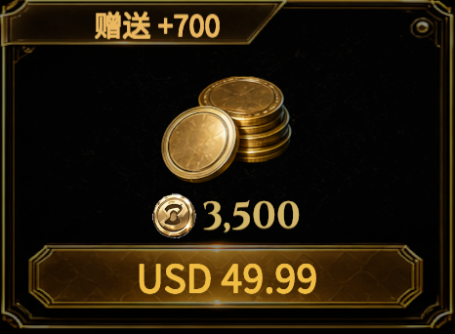
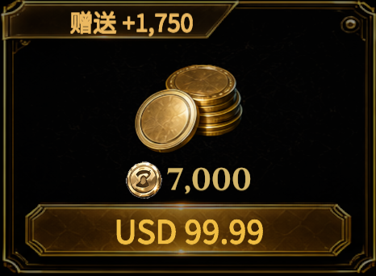

Our purchase journey connects top-ups to benefits
Top Up · Buy gold
BP · Battle Pass
Monthly membership
$0.99–$99.99
Upgrade: 300 in-game gold
30 days · $9.99
07
Notes:
Our purchase journey connects top-ups to benefits
07
Top Up · Buy gold
BP · Battle Pass
Monthly membership
$0.99–$99.99
Upgrade: 300 in-game gold
30 days · $9.99

Slide 8
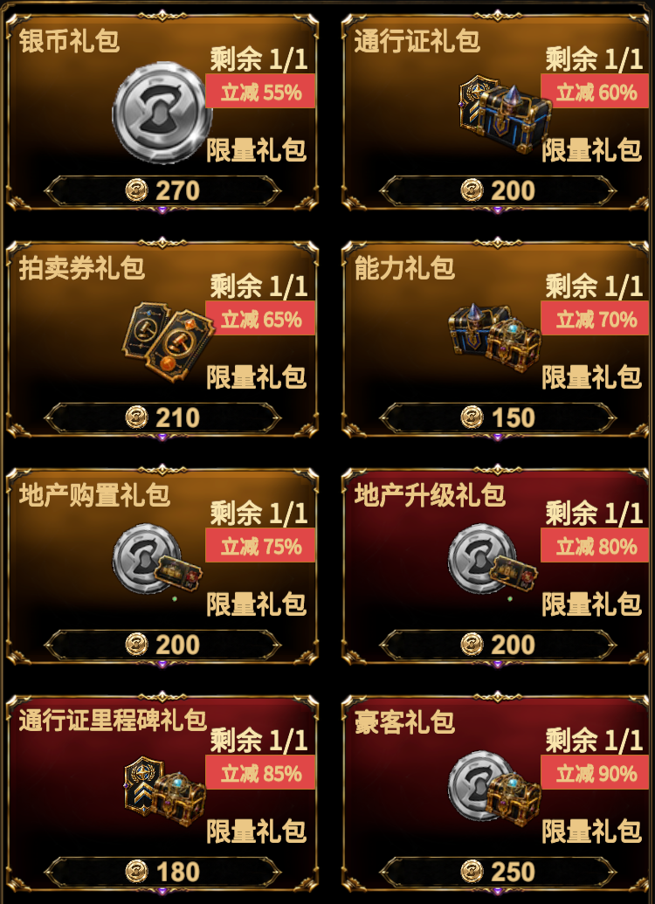
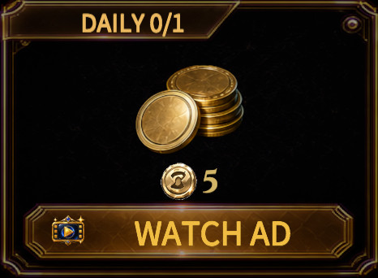

Rewarded ads and paid perks diversify revenue
Rewarded ads
Ad-free benefit
Special Deals
Watch an ad, earn 5 gold
$9.99 · Permanent
Optional viewing
Claim once per day
Skip rewarded ads on the account
and claim rewards directly
Bundles purchased with in-game gold
08
Notes:
Rewarded ads and paid perks diversify revenue
08
Rewarded ads
Ad-free benefit
Special Deals
Watch an ad, earn 5 gold
Optional viewing
Claim once per day
$9.99 · Permanent
Skip rewarded ads on the account
and claim rewards directly
Bundles purchased with in-game gold

Slide 9
We see international potential
in this proven gameplay model
The prototype and peers have reached scale
Reviews remain concentrated in Chinese
57,450
98.0%
BidKing peak concurrent players
Steam worldwide · 25 Apr 2026
BidKing reviews in Simplified Chinese
22,877 / 23,340 · 10 Sep 2026
No. 21
Jule Da Wanjia
Best-ever WeChat mini-game grossing rank
Already supports 14 interface languages
Our thesis: strategy, bargain hunting and collecting travel across cultures
Test target markets to validate profit potential
09
Notes:
We see international potential
in this proven gameplay model
09
The prototype and peers have reached scale
57,450
BidKing peak concurrent players
Steam worldwide · 25 Apr 2026
No. 21
Jule Da Wanjia
Best-ever WeChat mini-game grossing rank
Reviews remain concentrated in Chinese
98.0%
BidKing reviews in Simplified Chinese
22,877 / 23,340 · 10 Sep 2026
Already supports 14 interface languages
Our thesis: strategy, bargain hunting and collecting travel across cultures
Test target markets to validate profit potential

Slide 10

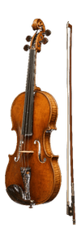



Designed for international players from day one
Western collectibles
Distinctive characters
European manors and palaces
Ruby
Damian
Whitestone Manor
Knight's armor
Classical violin
Adrian
Naomi
Vintage American neon sign
Grand palace
10 languages configured, including 9 non-Chinese languages, for international testing
10
Notes:
Designed for international players from day one
10
Western collectibles
Distinctive characters
European manors and palaces
Knight's armor
Classical violin
Vintage American neon sign
Ruby
Damian
Adrian
Naomi
Whitestone Manor
Grand palace
10 languages configured, including 9 non-Chinese languages, for international testing

Slide 11
The product is ready for small-scale commercial tests
Distribution | Current status
Google Play | Live and playable
App Store | Planned next
TapTap International | Integrated; preparing release
Localization | 10 selectable languages and localized content
Ongoing team support
Product and content development
Gameplay assets and build support
Localization and analytics integration
Use of initial funding
Validate analytics and payments → Create acquisition assets → Run capped-budget tests → Scale based on returns
11
Notes:
The product is ready for small-scale commercial tests
11
Distribution
Current status
Google Play
Live and playable
App Store
Planned next
TapTap International
Integrated; preparing release
Localization
10 selectable languages and localized content
Ongoing team support
Product and content development
Gameplay assets and build support
Localization and analytics integration
Use of initial funding
Validate analytics and payments → Create acquisition assets → Run capped-budget tests → Scale based on returns

Slide 12
Any one of these partnerships is a starting point
We welcome support in any one of these areas
Full publishing support
Gillian
Positioning, live operations, acquisition and monetization
contact@jackpot-rivals.com
Initial market testing
Email only
Test retention, spending and acquisition performance
Local publishing in selected markets
Play on Google Play
Localize and launch through regional channels
Partnership details
Strategic collaboration
jackpot-rivals.com
Explore product direction, resources and partnership models
12
Notes:
Any one of these partnerships is a starting point
12
We welcome support in any one of these areas
Full publishing support
Positioning, live operations, acquisition and monetization
Initial market testing
Test retention, spending and acquisition performance
Local publishing in selected markets
Localize and launch through regional channels
Strategic collaboration
Explore product direction, resources and partnership models
Gillian
contact@jackpot-rivals.com
Email only
Play on Google Play
Partnership details
jackpot-rivals.com

